Slide 1
Breathing systems

Slide 2
Mapleson B and C systems
Components
1. A reservoir bag. In the B system, corrugated tubing is attached to the bag and both act as a reservoir.
2. An APL valve at the patient’s end.
3. FGF is added just proximal to the APL.
Mechanism of action
Both systems are not efficient during spontaneous ventilation. A FGF of 1.5–2 times the minute volume is required to prevent rebreathing. During controlled ventilation, the B system is more efficient due to the corrugated tubing acting as a reservoir. A FGF of more than 50% of the minute ventilation is still required to prevent rebreathing.

Slide 3
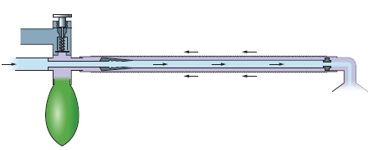
Fig. The Bain breathing system

Slide 4
Bain system(Mapleson D)
Components
1. A length of coaxial tubing (tube is 180 cm, but it can be supplied at 270 cm (for dental or ophthalmic surgery) and 540 cm (for magnetic resonance imaging MRI) scans where the anaesthetic machine needs to be kept outside the scanner’s magnetic field). Increasing the length of the tubing does not affect the physical properties of the breathing system.
2. The fresh gas flows through the inner tube while the exhaled gases flow through the outside tube. The internal lumen has a swivel mount at the patient end. This ensures that the internal tube cannot kink, so ensuring delivery of fresh gas to the patient.
3. The reservoir bag is mounted at the machine end.
4. The APL valve is mounted at the machine end.

Slide 5
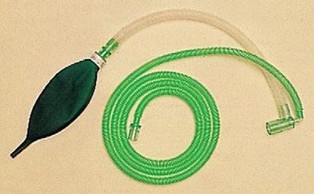
Fig. T-piece breathing system

Slide 6
T-piece system (Mapleson E and F)
Problems in practice and safety features
1. Since there is no APL valve used in this breathing system, scavenging is a problem.
2. Patients under 6 years of age have a low functional residual capacity (FRC). This problem can be partially overcome in the Mapleson F with the addition of the double-ended bag.

Slide 7
Waters canister (‘to-and-fro’)
Waters canister (‘to-and-fro’) bidirectional flow breathing system
Currently, this system is not widely used in anaesthetic practice. It consists of a Mapleson C system with a soda lime canister positioned between the APL valve and the reservoir. A filter is positioned in the canister to prevent the soda lime granules ‘entering’ the breathing system and the risk of inhaling them. It is not an efficient system as the granules nearest to the patient are exhausted first, so increasing the dead space. It is also a cumbersome system as the canister has to be positioned horizontally and packed tightly with the soda lime granules to prevent channeling of the gases.

Slide 8
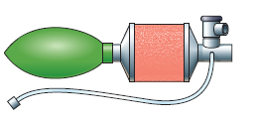
Fig. The Waters canister breathing system.

