Slide 1
Biochemistry

Slide 2
Biochemistry can be defined as the science concerned with the chemical basis of life. The cell is the structural unit of living systems. Thus, biochemistry can also be described as the science concerned with the chemical constituents of living cells and with the reactions and processes they undergo. By this definition, biochemistry encompasses large areas of cell biology, of molecular biology, and of molecular genetics.

Slide 3
The maintenance of health is that there be optimal dietary intake of a number of chemicals; the chief of these are vitamins, amino acids, fatty acids, various minerals, and water. Because much of the subject matter of both biochemistry and nutrition is concerned with the study of various aspects of these chemicals, there is a close relationship between these two sciences.

Slide 4
We believe that most if not all diseases are result of abnormalities of molecules, chemical reactions, or biochemical processes. The major factors responsible for causing diseases in animals and humans are :-
1. Physical agents: Extremes of temperature, sudden changes in atmospheric pressure, radiation, electric shock.
2. Chemical agents, including drugs: Certain toxic compounds, etc.
3. Biologic agents: Viruses, bacteria, fungi, higher forms of parasites.

Slide 5
4. Oxygen lack: Loss of blood supply, depletion of the oxygen-carrying capacity of the blood, poisoning of the oxidative enzymes.
5. Genetic disorders: Congenital, molecular.
6. Immunologic reactions: Autoimmune disease.
7. Nutritional imbalances: Deficiencies, excesses.
8. Endocrine imbalances: Hormonal deficiencies, excesses.
All of them affect one or more chemical reactions or molecules in the body.

Slide 6
Cell Structure & Function
The smallest organisms consist of single cells and are microscopic. Larger, multicellular organisms contain many different types of cells, which vary in size, shape, and specialized function. All cells of the simplest and most complex organisms share certain fundamental properties, which can be seen at the biochemical level.

Slide 7
Major Cell organelles are as follows:- 1.Cell Membrane- Cell membrane enclose the cell and regulates the in and out flow of substance. It is also known as plasma membrane which form the covering of animal cell. It is elastic, living, double layer and permeable membrane. It is made up of protein and lipid molecules.
Function-It regulated movement of molecules inside and outside the cell.

Slide 9
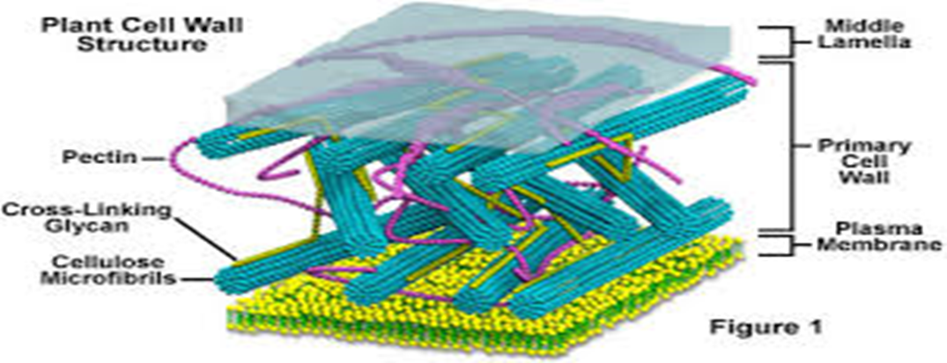
2. Cell Wall – The outer layer in the plant cell is called cell wall. The cell wall lies outside the plasma membrane. The plant cell wall is mainly composed of cellulose and pectin. Cellulose is a complex substance and provides structural strength to plant.

Slide 10
3. Protoplasm –The whole fluid present inside plasma membrane is protoplasm. Protoplasm is made up of various chemical substance like water ,ions, salt and organic molecule . Protoplasm is divided into two parts:- a) Cytoplasm – The fluid found outside the nuclear membrane. b) Nucleoplasm – The fluid found inside the nuclear membrane.

Slide 11
4. Nucleus- It is the most important organelle of a cell and usually lies in the center. Its basic function is cell division and multiplication. The nucleus has a double layered covering called nuclear membrane. The nucleus contains chromosomes .chromosome contain information for inheritance of parents to next generation in the form of DNA ( Deoxyribo Nucleic Acid) molecules.
Function- It controls all activity of cells. So it is also known as “control room “of cell. Chromatin transmits hereditary characters from parent of their offspring.

Slide 13
5. Mitochondria–These are cylinder rod shaped or spherical structure found in cytoplasm. It is surrounded by double layered membrane. Inner membrane has many fold. The area present inside mitochondria is called matrix, which contain many enzyme and co-enzyme.
Function- Mitochondria is the respiratory site of cellular respiration. Mitochondria synthesize energy rich compound ATP (Adenosine Triphopshate). Mitochondria are known as the Powerhouse of the cell.

Slide 15
6. Ribosome- Small granules like structure found attached to the endoplasmic reticulum or in Free State. It is made up of ribonucleic acid (RNA).
Function- Ribosome helps in protein Synthesis.
7. Lysosomes – Single membrane and contain hydrolytic enzyme.
Function- Digestive the proteins, fats, and carbohydrates.
- Transports undigested material to cell membrane for removal.
- Cell breaks down if lysosome explodes.

Slide 17
8. Endoplasmic Reticulum (ER)- Large network of tubules found in cytoplasm .it is attached with the nucleus on one side and on other side it is joined with plasma membrane .
There are two types of ER. a) Rough Endoplasmic reticulum (RER)- looks rough under a microscope because it has particles called ribosome attached to its surface.
Function- RER concerned with protein synthesis and transport.
b) Smooth Endoplasmic reticulum (SER) – looks smooth under a microscope because it has free ribosome particles on its surface.
Function- Helps in synthesizes and transports lipids and steroids.

Slide 19
9. Plastids- Plastids are present only in plant cells. There are three types of plastids:- a) Chromoplast (colored plastids) –It provides various colors to the plant. b) Chloroplasts– Plastids containing the pigment chlorophyll are known as chloroplast. Chloroplasts are important for photosynthesis in plants. c) Leucoplast (white or colorless plastids) – Leucoplasts are primarily organelles. It stores the food in the form of starch, fat and protein.

Slide 22
10. Vacuoles- Vacuoles are storage sacs for solid or liquid contents vacuoles are small sized in animal cells while plant cells have very large vacuoles. Many substances of importance in the life of the plant cell are stored in vacuoles. These include amino acids and some proteins.

Slide 23
Thank you

